Slide 1

What is a content crit?
“It’s a collaborative process. You share content, get constructive feedback, consider alternatives and bounce ideas around with support and advice.” – Jane McFadyen, content designer at DWP
Except where otherwise indicated, this work is under Creative Commons Attribution 4.0 International License

Slide 2
Why do a content crit?
We use content crits to provide perspective, improve the design and ultimately create a better product for the user.

Slide 3
Collective agreement
What behaviours can we all sign up to, to make sure today is useful and safe for everyone here?
Respect for everyone
Don’t assume knowledge or context
Be welcoming
Be fully engaged
Be open
Confidentiality
Put devices away
Background conversations to the foreground
Stay on topic
Stick to brief and time
Notes:
From GDS feedback - https://docs.google.com/presentation/d/16XT3AmbZkOlRds0hS0kaOwEMFPQu1Y8DlDUWK8Kwbxk/edit?usp=sharing

Slide 4
Good feedback
Getting feedback
Let the team review the work
don’t give a demo
don’t talk too much
don’t get defensive
do deflect questions
do take notes
do listen
Giving feedback
Listen to the context
ask questions if you need to
Give the right kind of feedback
avoid personal opinions
avoid absolute statements
ask open questions
be kind
explore ideas and suggest alternatives
X
“I don’t like X”
“Y never works”
✓
“What happens if…”
“Have you tried…”
Notes:
From GDS feedback - https://docs.google.com/presentation/d/16XT3AmbZkOlRds0hS0kaOwEMFPQu1Y8DlDUWK8Kwbxk/edit?usp=sharing

Slide 5
Remember!
Everyone did the best job they could with the information they had at the time.

Slide 6
MOJ DESIGN CRIT 2020
[What you are presenting]
[Name] / [Profession]
Feb 2020

Slide 7
OVERVIEW
January 2020
Notes:
Feel free to delete/not show any of the slides in this section - there may be too many

Slide 8
The problem
max 60 seconds
Example Using an interrupt pattern to improve the user journey for people checking if they are eligible for Legal Aid.

Slide 9
The context
max 60 seconds
Example Feedback has shown that the results page (can they get legal aid) is causing confusion/dissatisfaction for xx% of users.

Slide 10
Who are the users
max 60 seconds
Example Repeated users who need to check if they are eligible for Legal Aid

Slide 11
The challenges
max 60 seconds
Example It’s reported that users currently think they will / have got Legal Aid by reaching the end of the CLA journey.

Slide 12
Feedback type
max 60 seconds
Example Does the pattern we are looking to use fit the problem.

Slide 13
The scenario
max 60 seconds
Example Users have already found the service, entered some details about their situation and then click Continue...

Slide 14
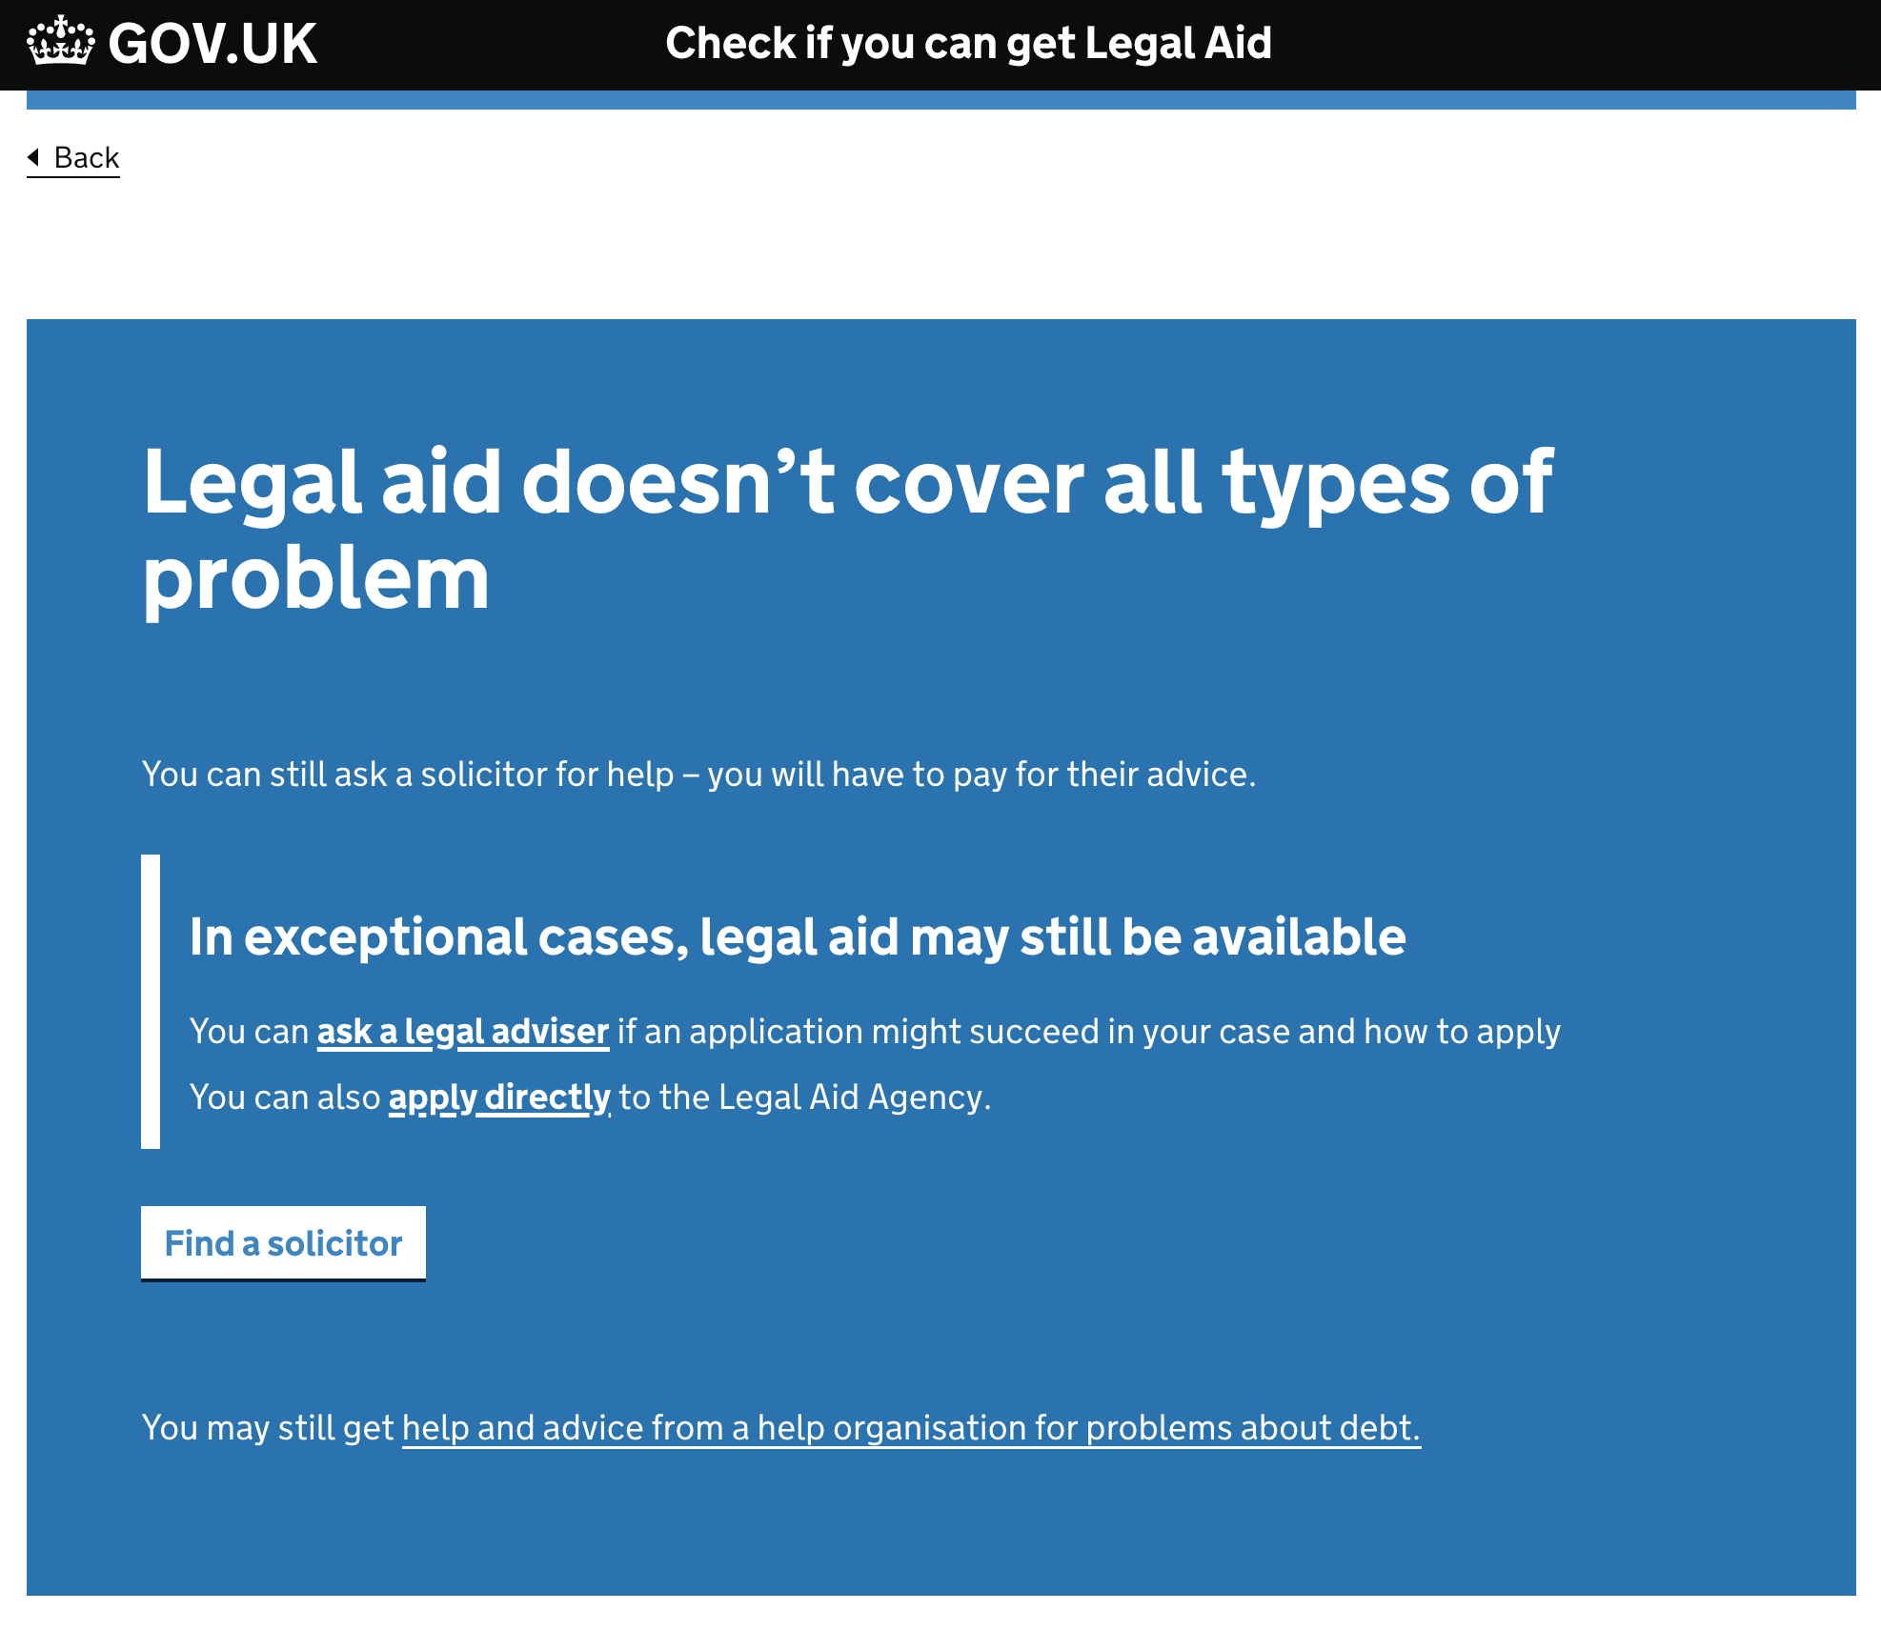
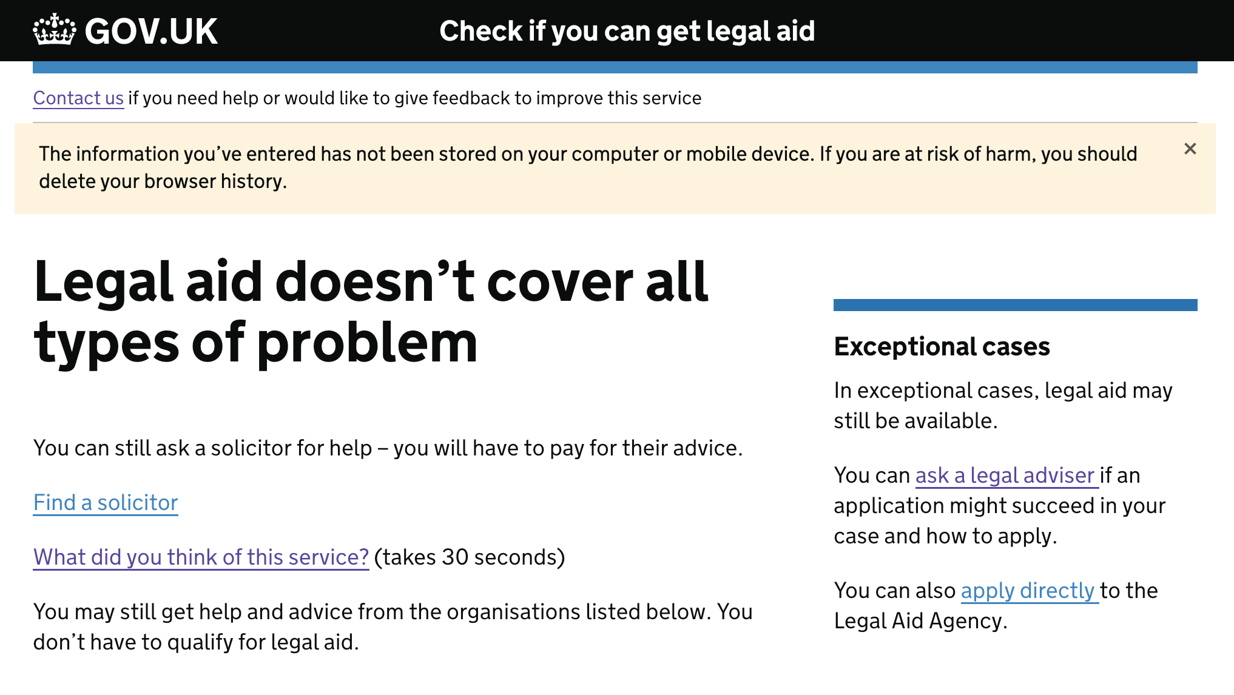
Show the thing!
60 seconds
Interrupt card design
Existing design

Slide 15
YOUR FEEDBACK
25 minutes
January 2020

